Slide 1
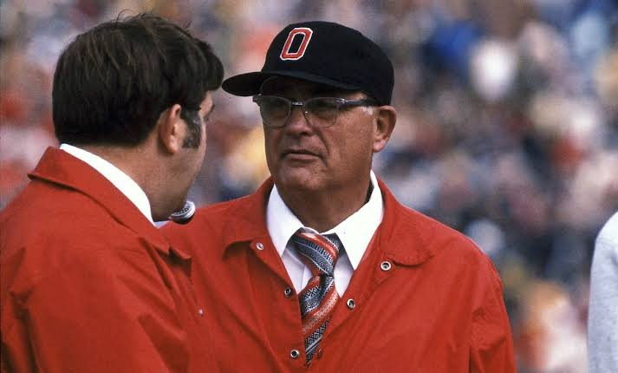
Run it Up
A Brief Exploration into PATs
and Two-Point-Conversions in the NFL

Slide 2
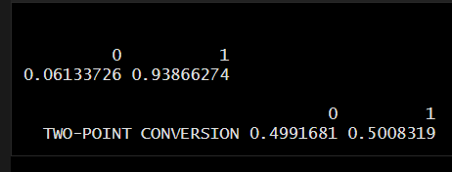
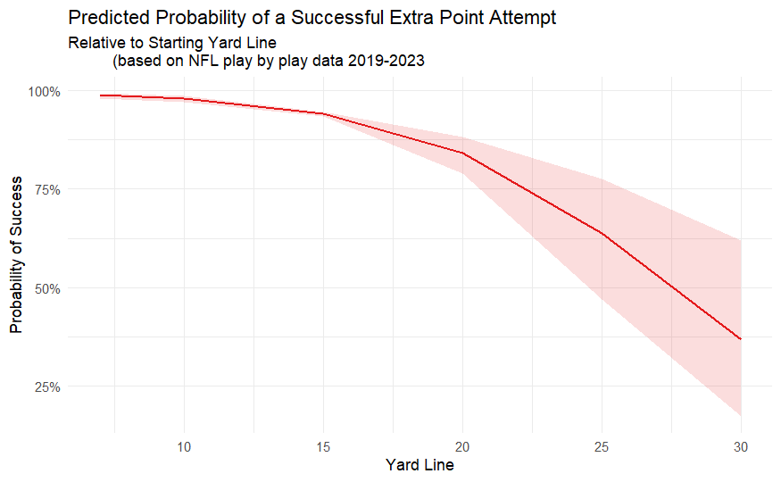
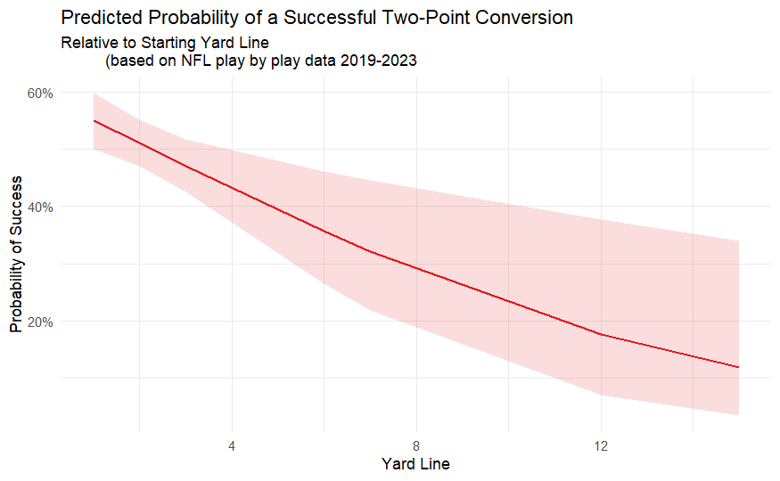
What I Wanted to Explore
Probabilities of Successful Try Attempts
Significance of distance (Yard Line) for each Try

Slide 3
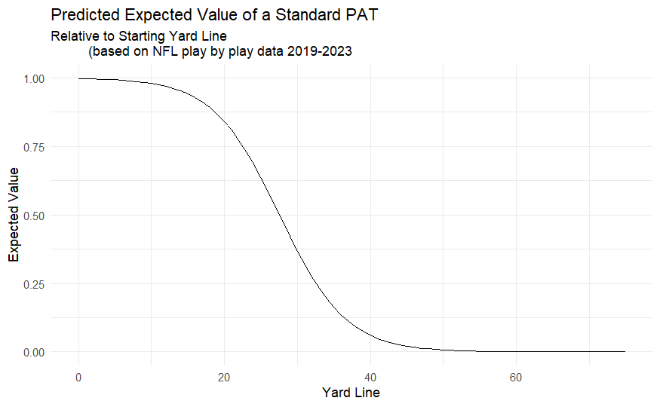
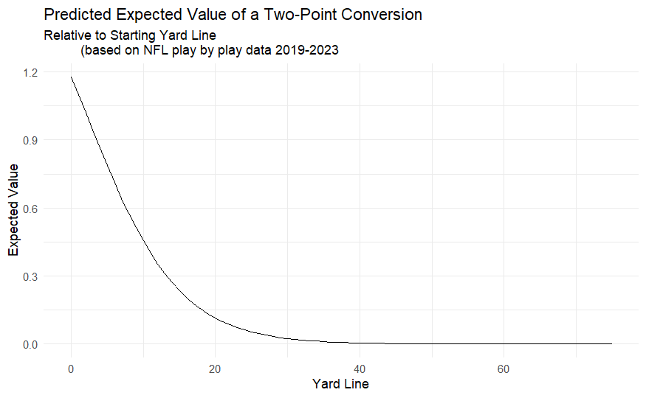
Findings cont

Slide 4
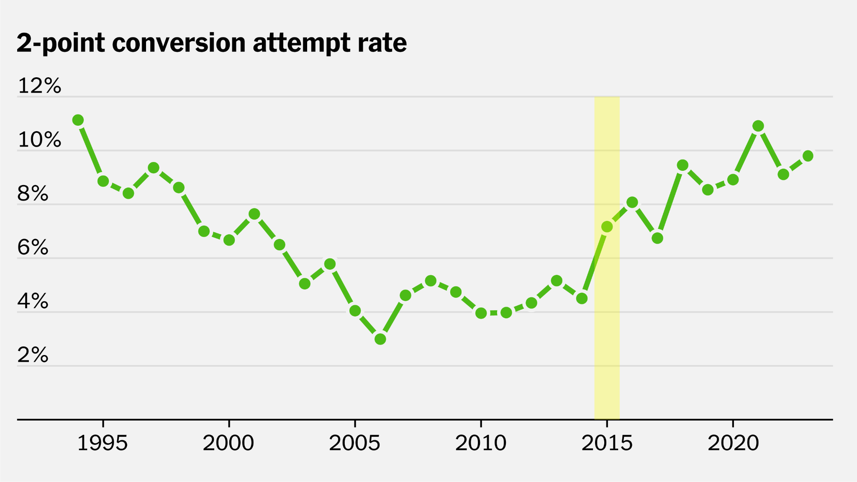
Why it Matters!
https://www.nytimes.com/2024/01/13/upshot/nfl-playoffs-2-point-conversion.html

